Slide 1
Network Environment Management
Managing Cisco Devices

Slide 2
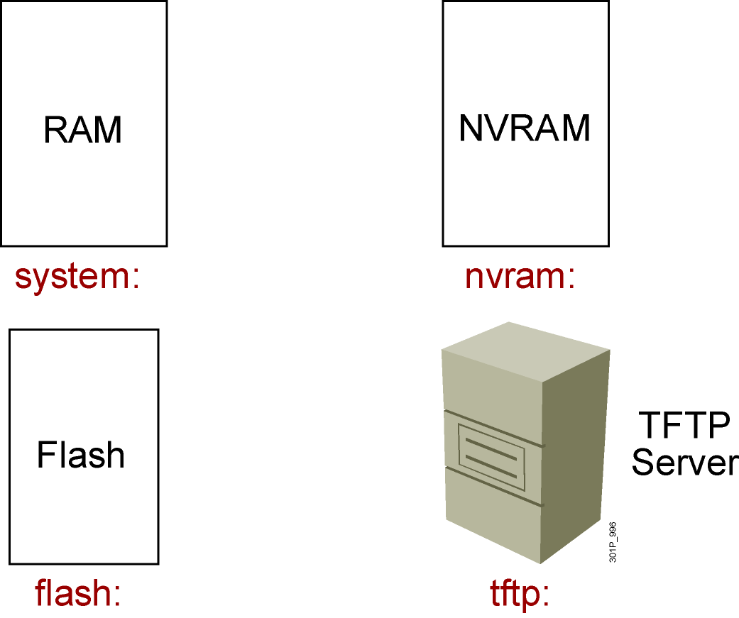
Cisco IOS File System and Devices
Notes:
Emphasize: In Cisco IOS Release 12.0, there are new copy commands. These new commands treat the RAM, Flash, NVRAM, TFTP, FTP, and so on as a file system. Since this class was developed when the most common Cisco IOS in the field is pre-12.0, these 12.0 commands are not covered in detail in this class.

Slide 3
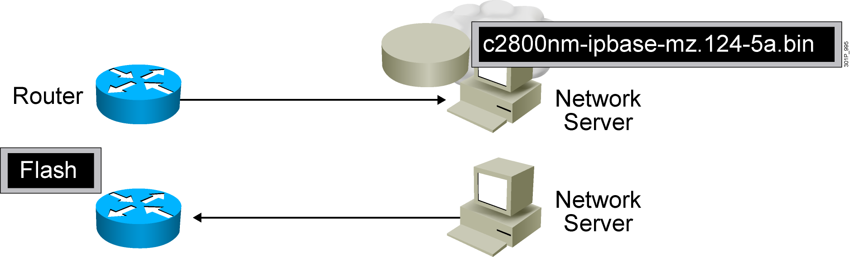
Managing Cisco IOS Images
Notes:
Emphasize: This section introduces topics on managing your configuration file and Cisco IOS image.

Slide 4
Verifying Memory and Deciphering Image Filenames
RouterX#sh flash
-#- --length-- -----date/time------ path
1 14951648 Feb 22 2007 21:38:56 +00:00 c2800nm-ipbase-mz.124-5a.bin
2 1823 Dec 14 2006 08:24:54 +00:00 sdmconfig-2811.cfg
3 4734464 Dec 14 2006 08:25:24 +00:00 sdm.tar
4 833024 Dec 14 2006 08:25:38 +00:00 es.tar
5 1052160 Dec 14 2006 08:25:54 +00:00 common.tar
6 1038 Dec 14 2006 08:26:08 +00:00 home.shtml
7 102400 Dec 14 2006 08:26:22 +00:00 home.tar
8 491213 Dec 14 2006 08:26:40 +00:00 128MB.sdf
41836544 bytes available (22179840 bytes used)
Verify that flash memory has room for the
Cisco IOS image.
Notes:
Emphasize: The show flash command is an important tool to use to gather information about your router memory and image file. Caution students that they must know that they are loading the correct and appropriate image. The name for the Cisco IOS image file contains multiple parts, each with a specific meaning:
The first part of the image name contains the platform on which the image runs. In this example, the platform is C2500.
The second part of the name identifies the special capabilities of the image file. A letter or series of letters identifies the feature sets supported in that image. In this example, the “j” indicates this is an enterprise image, and the “s” indicates it contains extended capabilities.
The third part of the name specifies where the image runs and if the file is compressed. In this example, “l” indicates the file is relocatable and not compressed. Relocatable means the Cisco IOS can be run from Flash or from RAM. You should be careful in reading the Cisco IOS image filename. Some fonts display the lowercase letter “l” and the number 1 as the same character. How you enter the characters will impact the ability of the router to load the files correctly.
The fourth part of the name indicates the version number. In this example, the version number is 12.0 (3).
The final part of the name is the file extension. The .bin extension indicates this file is a binary executable file.
The Cisco IOS software naming conventions, name part field meaning, image content, and other details are subject to change. Refer to Cisco Connection Online (CCO) for updated details.

Slide 5

Creating a Software Image Backup
RouterX#copy flash tftp:
Source filename []? c2800nm-ipbase-mz.124-5a.bin_x0003_Address or name of remote host []? 10.1.1.1
Destination filename [c2800nm-ipbase-mz.124-5a.bin]
!!!!!!!!!!!!!!!!!!!!!!!!!!!!!!!!!!!!!!!!!!!!!!!!!!!!!!!!!!!!!_x0003_<output omitted>
12094416 bytes copied in 98.858 secs (122341 bytes/sec)
RouterX#
Back up current files prior to updating flash memory.
Notes:
Purpose: This slide discusses how to create a backup version of a Cisco IOS software image to a TFTP server.
Emphasize: Routers by default come with Flash memory that has a preloaded copy of the Cisco IOS software. Although Flash is extremely reliable—good for 65 years and 100,000 rewrites—it is a good idea to make a backup copy of the Cisco IOS software if you have a TFTP server available. If you have to replace Flash memory for some reason, you will have a backup copy at the revision level currently running on your network.
The copy command screen output varies depending on the Cisco IOS software level.
Determine the platform type of your TFTP server prior to beginning the backup procedure. The TFTP server may be running Windows, UNIX, Mac, or other OS. Filename and directory access procedures may vary depending on the TFTP server platform and platform version.

Slide 6

Upgrading the Image from the Network
RouterX#copy tftp flash:
Address or name of remote host [10.1.1.1]?
Source filename []? c2800nm-ipbase-mz.124-5a.bin
Destination filename [c2800nm-ipbase-mz.124-5a.bin]
Accessing tftp://10.1.1.1/c2600-js-mz.122-21a.bin...
Erase flash: before copying? [confirm]
Erasing the flash filesystem will remove all files! Continue? [confirm]
Erasing device... eeeeeeeeee (output omitted) ...erased
Erase of flash: complete
Loading c2800nm-ipbase-mz.124-5a.bin from 10.1.1.1 (via Ethernet0/0): !!!!!!!!!!!!!!!
(output omited)
[OK - 12094416 bytes]
Verifying checksum... OK (0x45E2)
12094416 bytes copied in 120.465 secs (100398 bytes/sec)
RouterX
Notes:
Purpose: This slide describes how to load a backup version of a Cisco IOS software image from a TFTP server to the router.
Emphasize: If you need more Flash space to load a copy of the Cisco IOS software, you must first erase the Flash memory. You cannot erase a single image—you must erase all copies of Cisco IOS software from Flash. However, if Flash memory on the router is partitioned, you can erase one or more of the parts.
After the TFTP transfer is completed, use the show flash command to view the file size to compare its size with that of the original on the server.
If the Cisco IOS is running from Flash, then the Flash is in the read-only state. To change the Flash to a writeable state, you can use the boot system TFTP command to boot a Cisco IOS from a TFTP server and the Cisco IOS will be run from RAM, or you can go to the Rxboot mode to perform the copy.

Slide 7
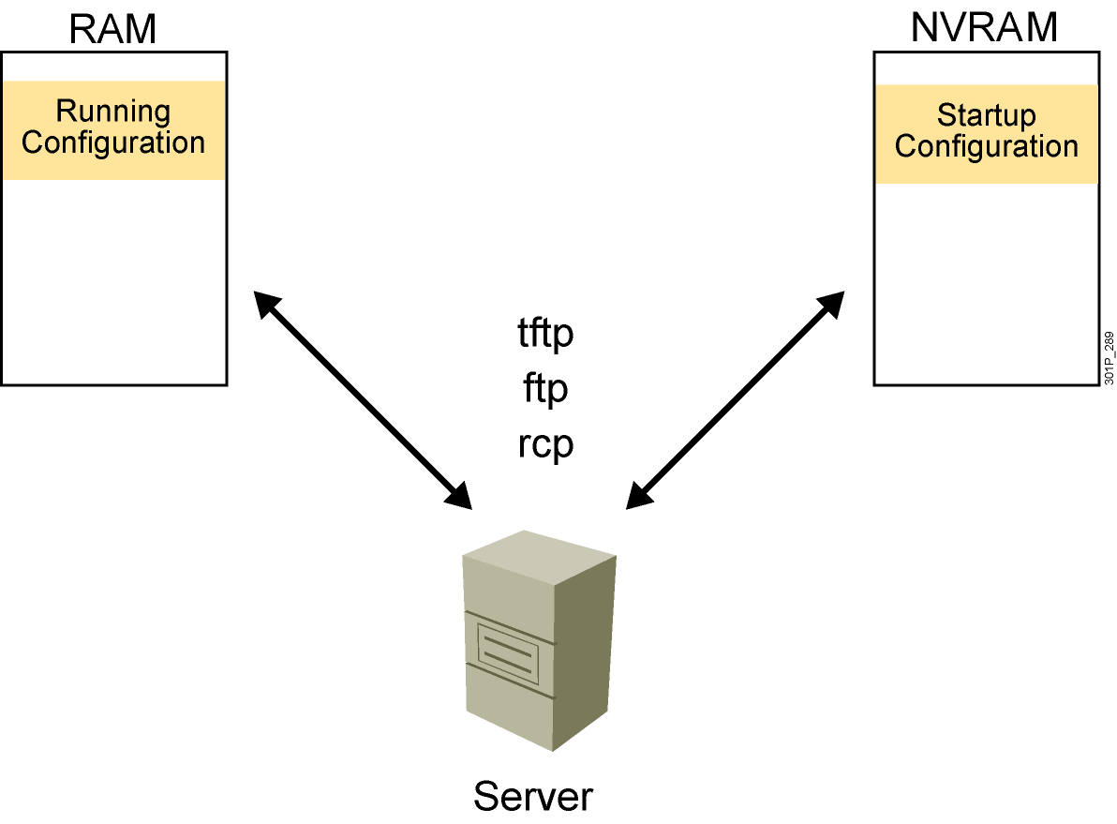
Device Configuration Files

Slide 8
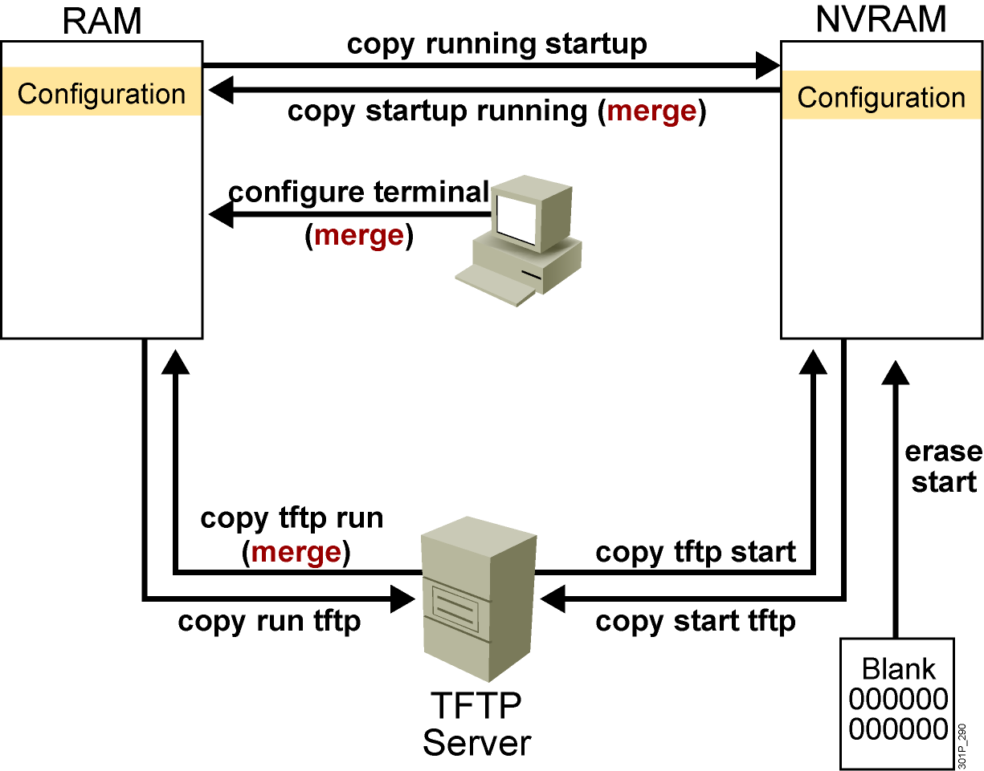
Cisco IOS copy Command
  NVRAM
  Terminal
  TFTP server
  Erase start
Notes:
Layer 4 of 4

Slide 9
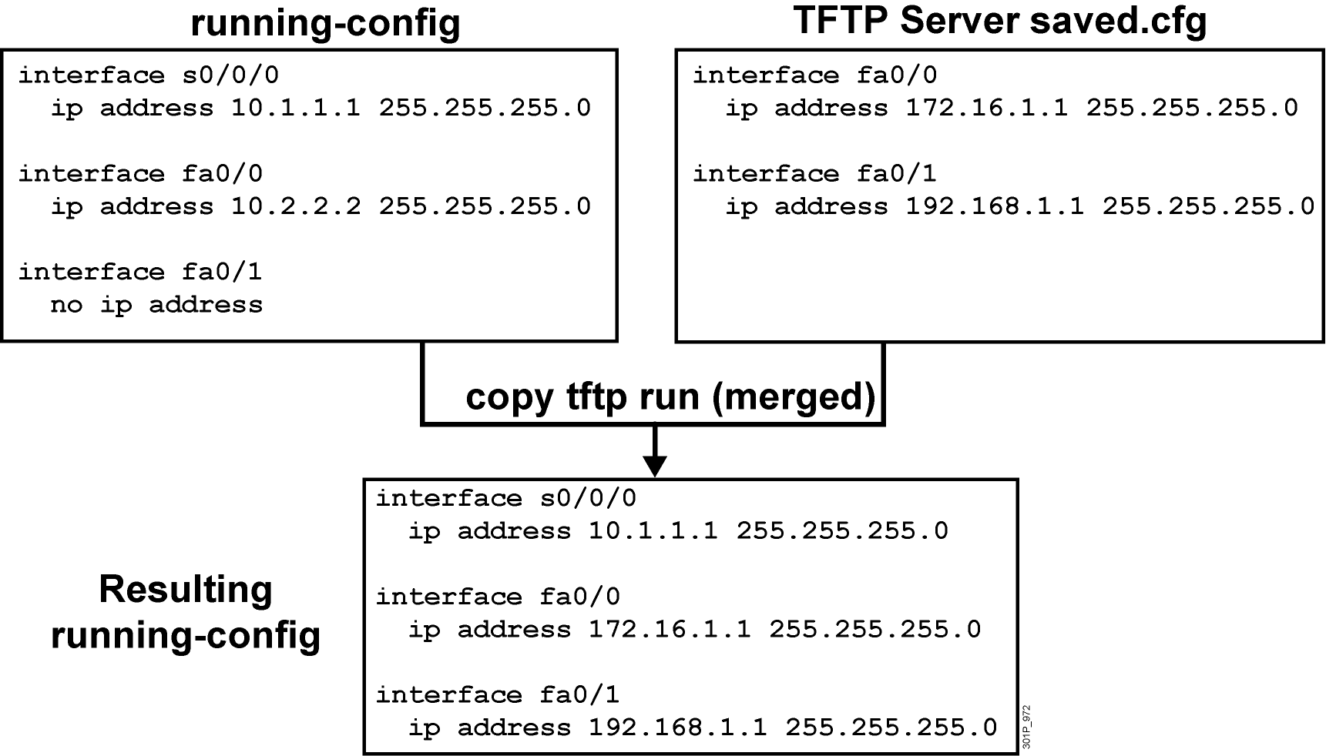
Cisco IOS copy Command Example
Notes:
Note: Cisco IOS Release 12.0 supports a new syntax for the copy command.

Slide 10
copy run tftp and copy tftp run Commands
RouterX#copy running-config: tftp:
Address or name of remote host []? 10.1.1.1
Destination filename [running-config]? wgroa.cfg
.!!
1684 bytes copied in 13.300 secs (129 bytes/sec)
RouterX#copy tftp: running-config:
Address or name of remote host []? 10.1.1.1
Source filename []? wgroa.cfg
Destination filename [running-config]?
Accessing tftp://10.1.1.1/wgroa.cfg...
Loading wgroa.cfg from 10.1.1.1 (via Ethernet0): !
[OK - 1684/3072 bytes]
1684 bytes copied in 17.692 secs (99 bytes/sec)
Notes:
Note: Cisco IOS Release 12.0 supports a new syntax for the copy command.

Slide 11
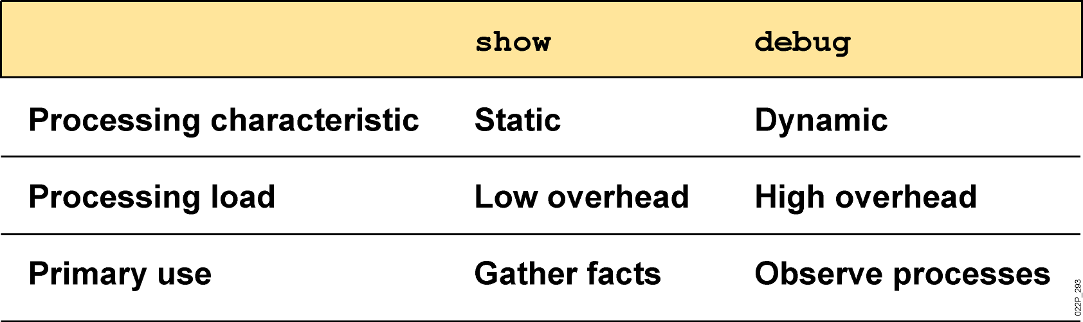
show and debug Commands

Slide 12
Considerations When Using debug Commands
  May generate output in a variety of formats that may not identify the problem
  Require high overhead, possibly disrupting network device operation
  Useful for obtaining information about network traffic and router status

Slide 13
Commands Related to debug
RouteX(config)#
service timestamps debug datetime msec
Adds a time stamp to a debug or log message
RouteX#
show processes
Displays the CPU utilization for each process
RouteX#
no debug all
Disables all debug commands
RouteX#
terminal monitor
Displays debug output on your current vty session

Slide 14
Summary
  The Cisco IFS feature provides a single interface to all the file systems (NVRAM, RAM, TFTP, flash) that a router uses.
  As a network grows, storage of the Cisco IOS Software and configuration files on a central server enables control of the number and revision level of software images and configuration files that must be maintained.
  Having proper backup of the current device configuration stored in a TFTP server can help reduce device downtime.
Notes:
Purpose: This slide discuss the initial configurations on the routers and switches.
Note: There is no setup mode on the Catalyst 1900 switch.

Slide 15
Summary (Cont.)
  The Cisco IOS Software copy commands can be used to move configurations from one component or device to another, such as RAM, NVRAM, or a file server.
  The show and debug commands are built-in tools for troubleshooting. The show command is used to display static information, while the debug command is used to display dynamic data.

